Slide 1






To Search or to Recommend:
Predicting Open-App Motivation
with Neural Hawkes Process
Zhongxiang Sun¹, Zihua Si¹, Xiao Zhang¹, Xiaoxue Zang²
Song Yang² Hongteng Xu¹ Jun Xu¹
¹Gaoling School of Artificial Intelligence, Renmin University of China
²Kuaishou Technology Co., Ltd.
KUAISHOU
TECHNOLOGY
Notes:
Hello everyone, My name is Zhongxiang Sun from Gaoling school of Artificial Intelligence，remin university of china,

Slide 2
Outline
Background
Methodology
Experiment
Conclusion
Notes:
First of all，I will give the background of open app motivations

Slide 3

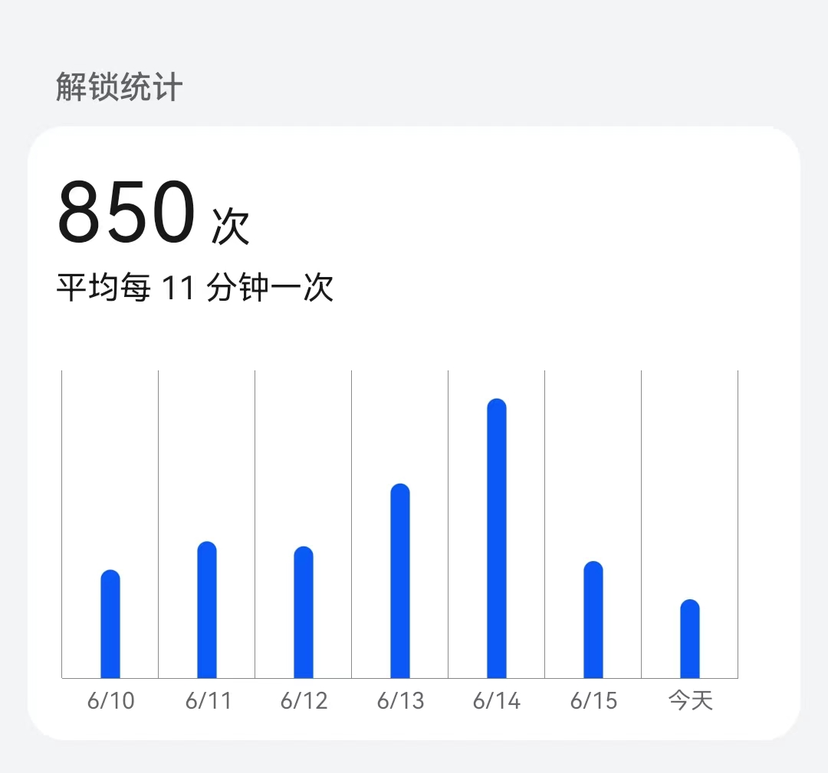



Open-App
Open-App happens everywhere:
Subway
Unlock statistics
times
Once every 11 minutes on average
Restaurant
Opening Apps
Workstation
Today
We can not live without using phone, or exactly without opening Apps
Notes:
So what is Open-App， Open-App happens everywhere
Subway，restaurant，workstation always open-apps
The right figure is the unlock statistic from my phone which reaches such a high frequency
We cant live without phone exactly without Opening App
(At least that's how I am.)

Slide 4



Open-App Motivation
Integrate
The way is so boring;
Listen recommended musics to pass the time.
This dish is so delicious, I want to search how
to make it.
My code encountered a bug, search how to fix it.
…
Two primary open-app motivations:
Embrace suggestions from the recommender system
Employ the search engine for information seeking
Notes:
We know that open app motivation happens any where and any time, Have you ever wondered why we open apps, or what motivations drive us to open apps?
Take myself as example,
Nowadays， Incorporating Search and Recommendation services within a singular application is prevalent in online platforms, such as the TikTok kwai, X and so on.
Two primary open-app motivations:
Embrace suggestions from the recommendation system
Employ the search engine for information seeking
Our task is to predict whether users initiate the application with the specific intent of information searching, or to explore recommended content for entertainment.

Slide 5






User flow through the application
User Retention Prediction
Whether
open the App
Open-App Motivation Prediction
Why
For Recommendation
For Searching
Search
Recommendation
Retrieval → Ranking → Reranking
Notes:
Here, we give the user flow through the application usage,
First, User Retention Prediction is to predict whether the user open the App and
then our Open-App Motivation Prediction is to predict why user open the App for recommendation or searching.
After the user open the app the search and recommendation engine will work to provide the relate information content for users
As we can see, our task is just in the middle between the User Retention Prediction and Search and recommendation tasks. Our task fill in gaps ，making the User flow completion。

Slide 6
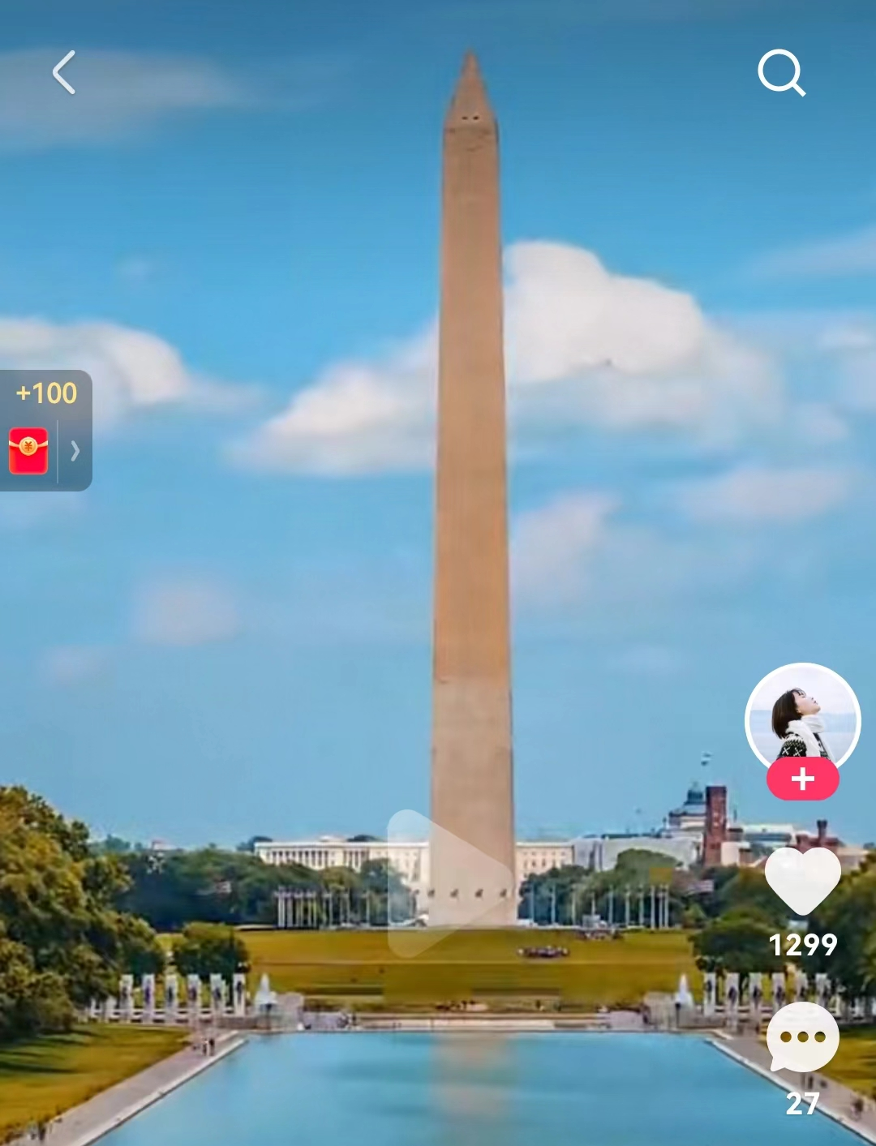
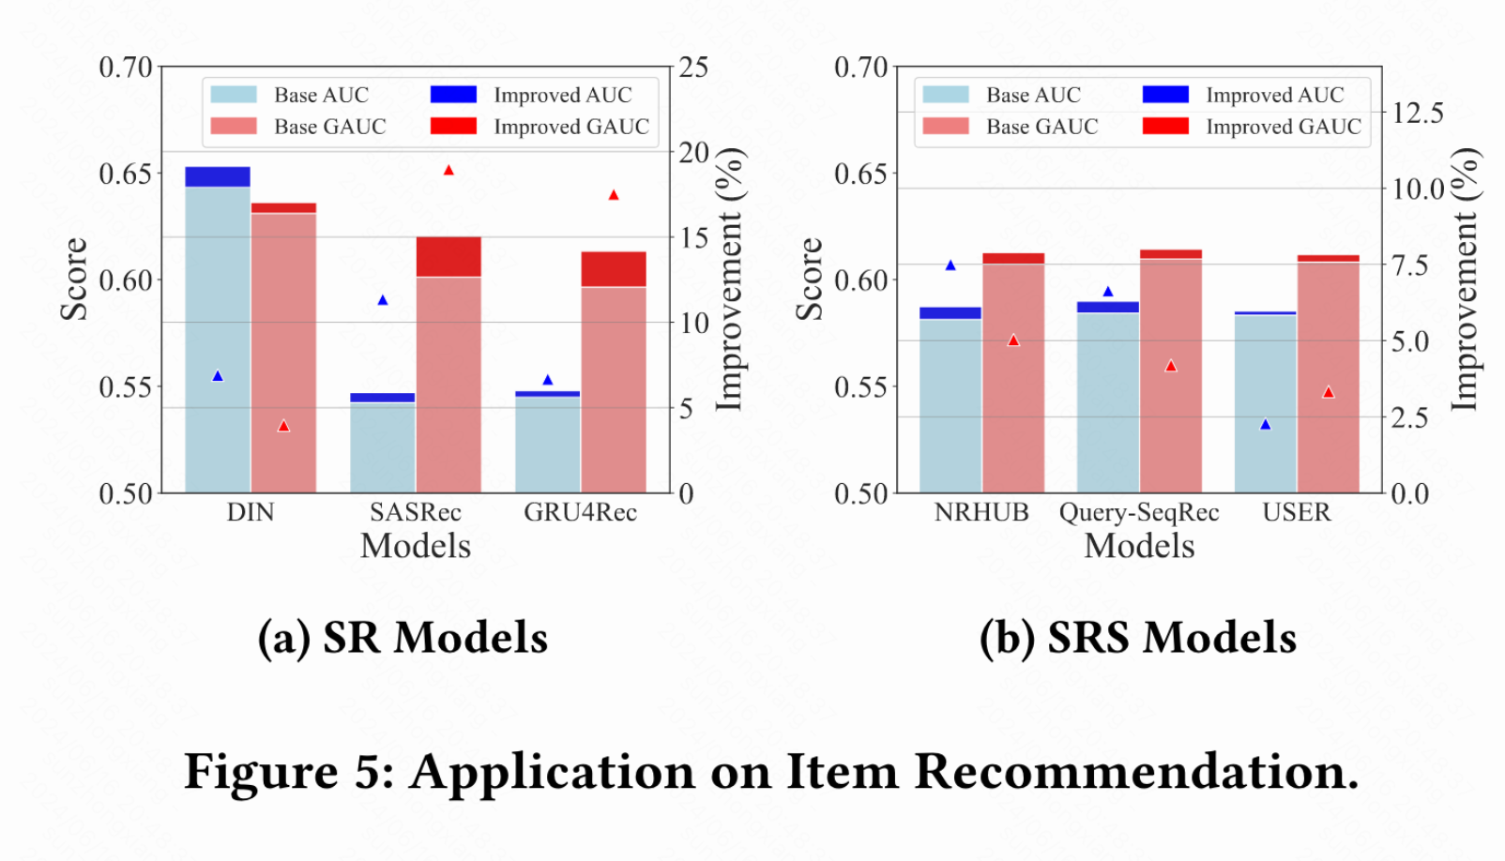
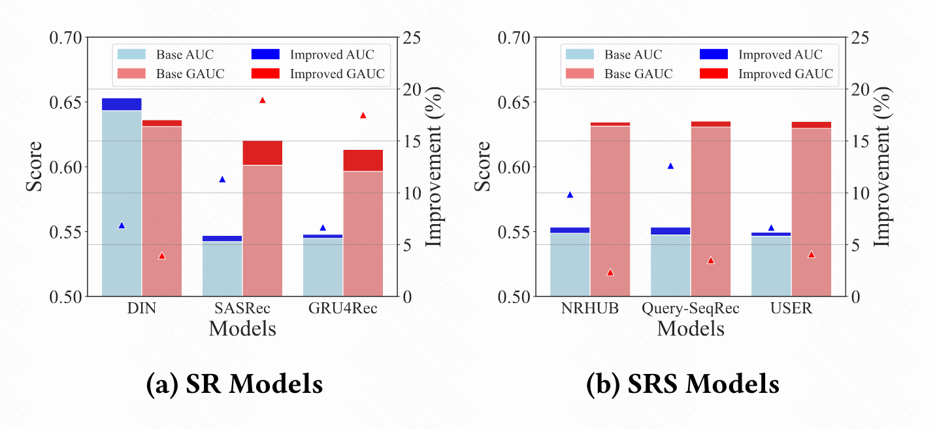


Significance of Open-App Motivation
Enhancing user engagement:
Results:
Related value of open-app to search increased from 0.1% to 0.8%.
Competition:
87% of gains from search.
13% from a decrease in returns from recommended videos.
Solution: Dynamically adjust search and recommendation modules.
Application in downstream tasks:
Previous
Not easy to find
Now
prominent
Application on Item Recommendation.
Application on Open-App Item Recommendation.
Notes:
Someone may ask Predicting users' open-app motivations sounds very interesting, but what specific value does it offer?
I think the following two experiments may answer that question
The first experiment was done on Kwai apps a short video platform with billions of users. The experiment is when moving the search module from the not easy to find position to prominent position，
the Related value of open-app to search increased from 0.1% to 0.8%. This is a big improvement on business metrics.However， this improvement leads to Competition 87% of gains from search and 13% from a decrease in returns from recommended videos.
One solution is to Dynamically adjust search and recommendation modules by predicting users’ open-app motivations.
The Second experiment was to add the open-app motivations representation to underlying Application，which can also lead to big improvement.
As we have seen the value of predicting open-app motivation. So How to predict user’s Open-App Motivation?

Slide 7
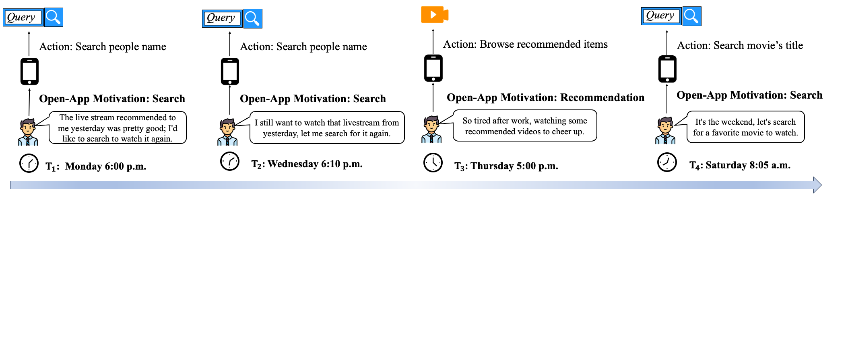
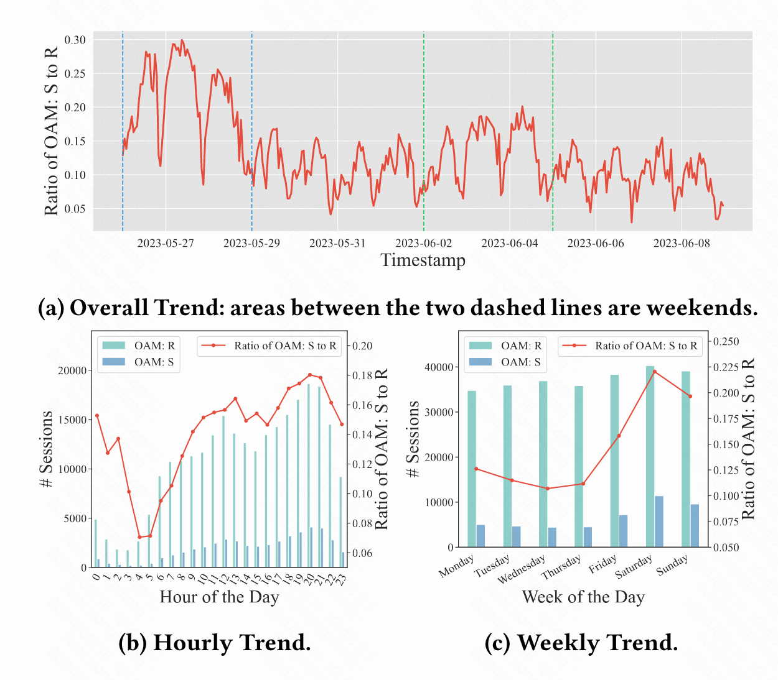
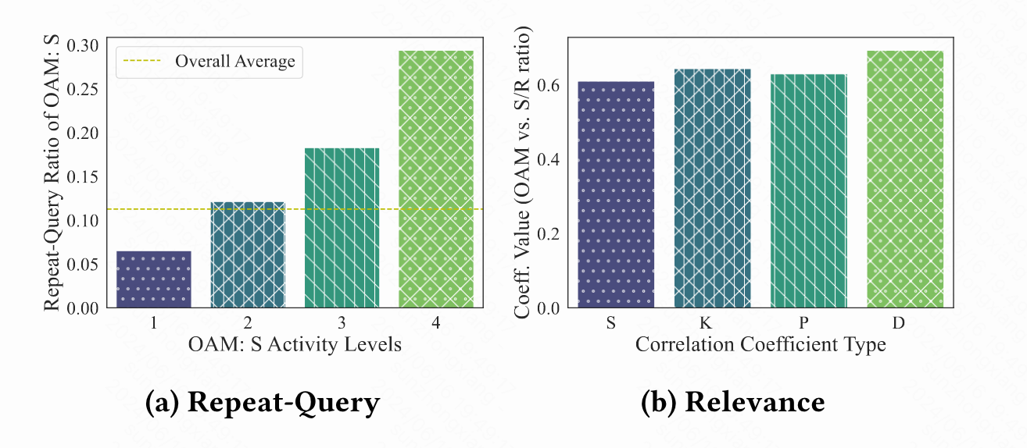
Behavioral Patterns
Repeat-Query Relevance
Periodicity
Periodicity
User interest
①:
②:
③:
① Periodicity: High search motivation during lunch breaks, after work, and on weekends.
② Repeat-Query: Users tend to open the app due to the same search query.
③ Relevance: Users‘ session behavior influences their next session’s
open-app motivation.
Notes:
We firstly analyze the Behavioral Patterns of users’ open-app motivations
The Figure shows the user study of user’s open-app motivations from structural interview，one major factor influencing users‘ motivation to open the app is user interest. Then the user may search for the same query or have a Periodicity behavior.
Then we statistical analysis the Behavioral Patterns between open app motivations and find that user’s open app motivations exist prevalent Periodicity, user tend to have a higher search motivation during daily lunch breaks, after work hours, and on weekends.
Besides, Users tend to open the app due to the same search query， the more activate the more repetitive. The average repeat ratio reach over 10%。
Moreover, Users’s last session behavior influences their next session‘s open-app motivation, the more search actions in the last session the more probability user open app to search.

Slide 8
Outline
Background
Methodology
Experiment
Conclusion
Notes:
OK，based on the above observation，we will begin the introduction of Methodology

Slide 9
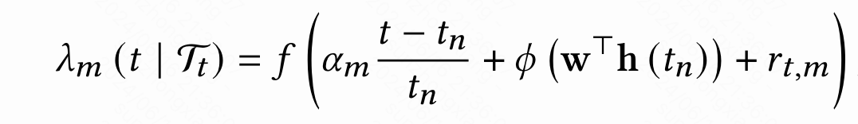
Method: NHP-OAM
Neural Hawkes Process-based Open-App Motivation
Neural Hawkes Process: A temporal point process that model temporal dependencies and complex patterns of events.
Intensity Function represents the probability of search/recommend motiv ation:
Repeat-Query
Periodicity
Relevance
Linear interpolation neural intensity
Ratio of in session search/recommend
Temporal Dynamic Modeling
Adjusting the intensity function to reflect these Periodicity.
Temporal Self-exciting Mechanism
Identify and predict users’ behavior of Repeat-Query.
High Explainability
Relevance scores as induction bias to model the relevance feature.
Notes:
In order to better predict the open app motivation and leverage the feature as mentioned above, we propose to use a math tool Neural Hawkes Process， A temporal point process that model temporal dependencies and complex patterns of events
We propose NHP-OAM by adapting Neural Hawkes Process to predict use’s Open-App Motivation.
The Intensity Function is the core of Neural Hawkes Process，in open app motivation prediction，the Intensity Function represents the probability of search/recommend motivation。
Here we use the linear interpolation neural intensity
1. The Temporal Dynamic Modeling capability of Neural Hawkes Process can adjust the intensity function to reflect these Periodicity
2. The Temporal Self-exciting Mechanism of Neural Hawkes Process can help Identify and predict users’ behavior of Repeat-Query
3. Finally we add the Relevance score as induction bias to model the relevance feature.

Slide 10
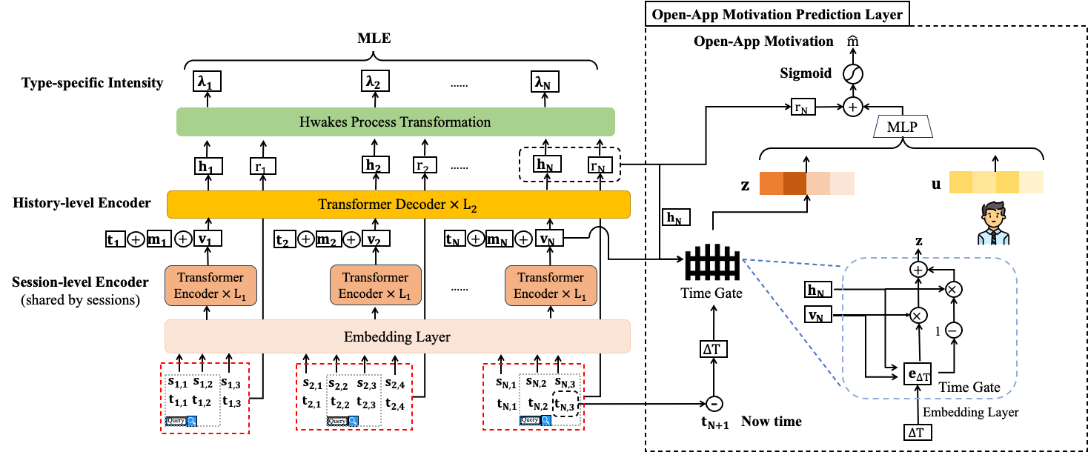
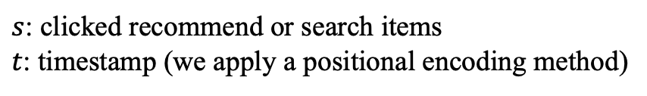
NHP-OAM: History Encoder
$s$: clicked recommend or search items
$t$: timestamp (we apply a positional encoding method)
Session-level Encoder: generate $v_{n}$ representing session intent using transformer encoder.
History-level Encoder: generate $h_{n}$ for the intensity function and long-term history representation.
Notes:
The History Encoder of NHP-OAM’s input is the session of items and corresponding time. The items can be clicked recommend or search items. The time is encoded using sin/cos positional encoding.
The history encoder includes Session-level Encoder to generate $v_{n}$ representing session intent using transformer encoder.
The History-level Encoder generate $h_{n}$ for the intensity function and long-term history representation using transformer decoder.

Slide 11
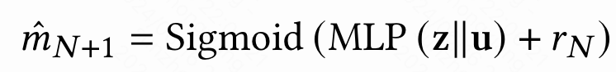
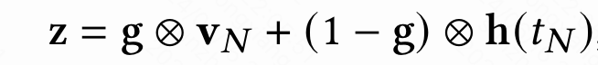
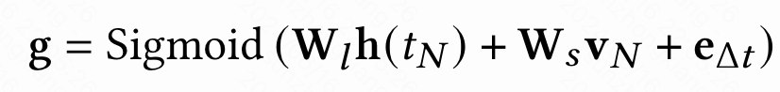
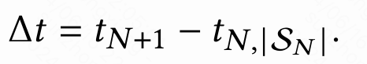
NHP-OAM: Prediction Layer
R1: Zuo et al., 2020 showed adding an additional prediction layer on top of the neural Hawkes processes model yields better performance.
R2: Add more user specific features and time information.
Simiao Zuo, Haoming Jiang, Zichong Li, Tuo Zhao, and Hongyuan Zha. 2020. Transformer hawkes process. In International conference on machine learning. PMLR, 11692–11702.
Notes:
The final module of NHP-OAM is the Prediction Layer，the first reason to add Prediction Layer is because Zuo showed adding an additional prediction layer on top of the neural Hawkes processes model yields better performance. Moreover we can add more user specific features and time information for better predicting user open-app motivations.
The prediction layer contains the Time Gate to learn the Periodicity feature and concatenated with the user embedding for final prediction.

Slide 12
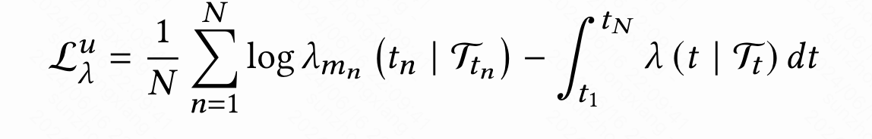
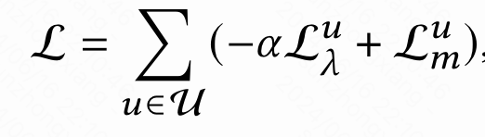
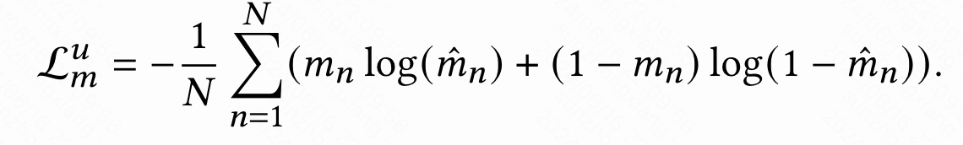
NHP-OAM: Training
Maximize the log-likelihood of Intensity:
Multi-objective joint optimization:
Minimize Binary Cross Entropy:
Notes:
The Training process of NHP-OAM is Multi-objective joint optimization which Simultaneous optimize the Maximize the log-likelihood of Intensity and Minimize Binary Cross Entropy.

Slide 13
Outline
Background
Methodology
Experiment
Conclusion

Slide 14
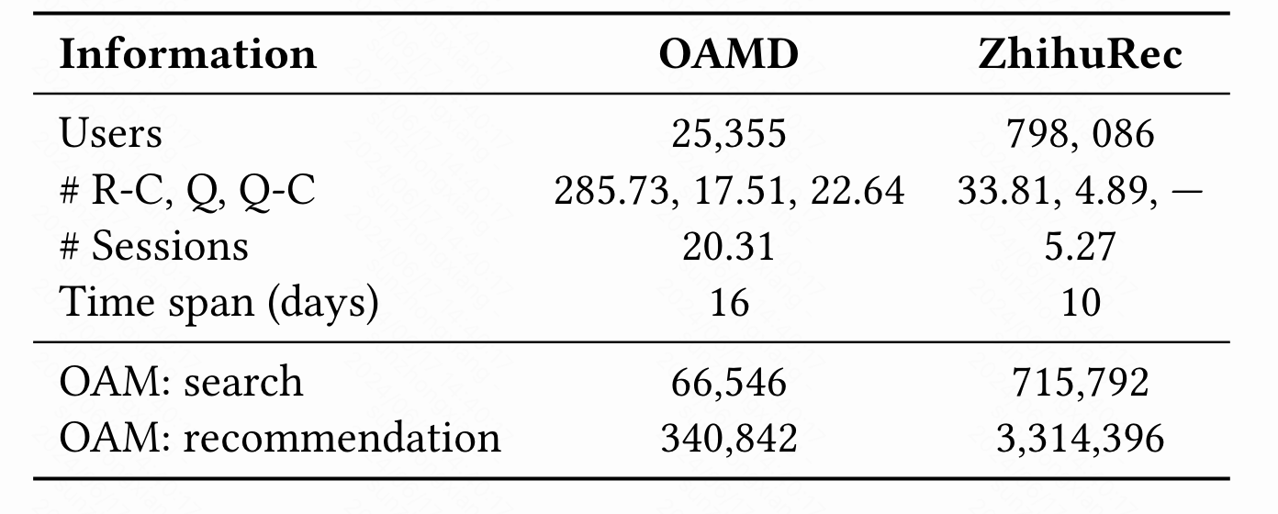
Experiments Setup
Dataset:
OAMD: A new real-world Open-App Motivation dataset
ZhihuRec: Extended public S&R dataset
Open-App motivation label:
Search: If the user actively searches within 30 seconds.
Recommendation: If the user does not search within 30 seconds.
This classification method is rooted in the platform’s comprehensive data analytics and business strategy.
Notes:
In order to better evaluate the

Slide 15
Experiments Setup
Evaluation Metrics:
Accuracy, Precision, F1-Score, F0.5-Score, and AUC
Baseline Models:
Sequential Recommendation Models (SR): 1. GRU4Rec 2. SASRec 3. BERT4Rec
Joint Search-Recommendation Sequential Models (SRS):
1. NRHUB 2. Query-SeqRec 3. USER
c. Time-Aware Sequential Recommendation Models (TSR):
1. TiSASRec 2. RESETBERT4Rec 3. TLSRec
d. Time-Series Models (TS)： 1. LSTNet 2. Autoformer 3. Dlinear
e. Neural Hawkes Process Models (NHP): 1. CTNHP 2. SAHP 3. THP

Slide 16
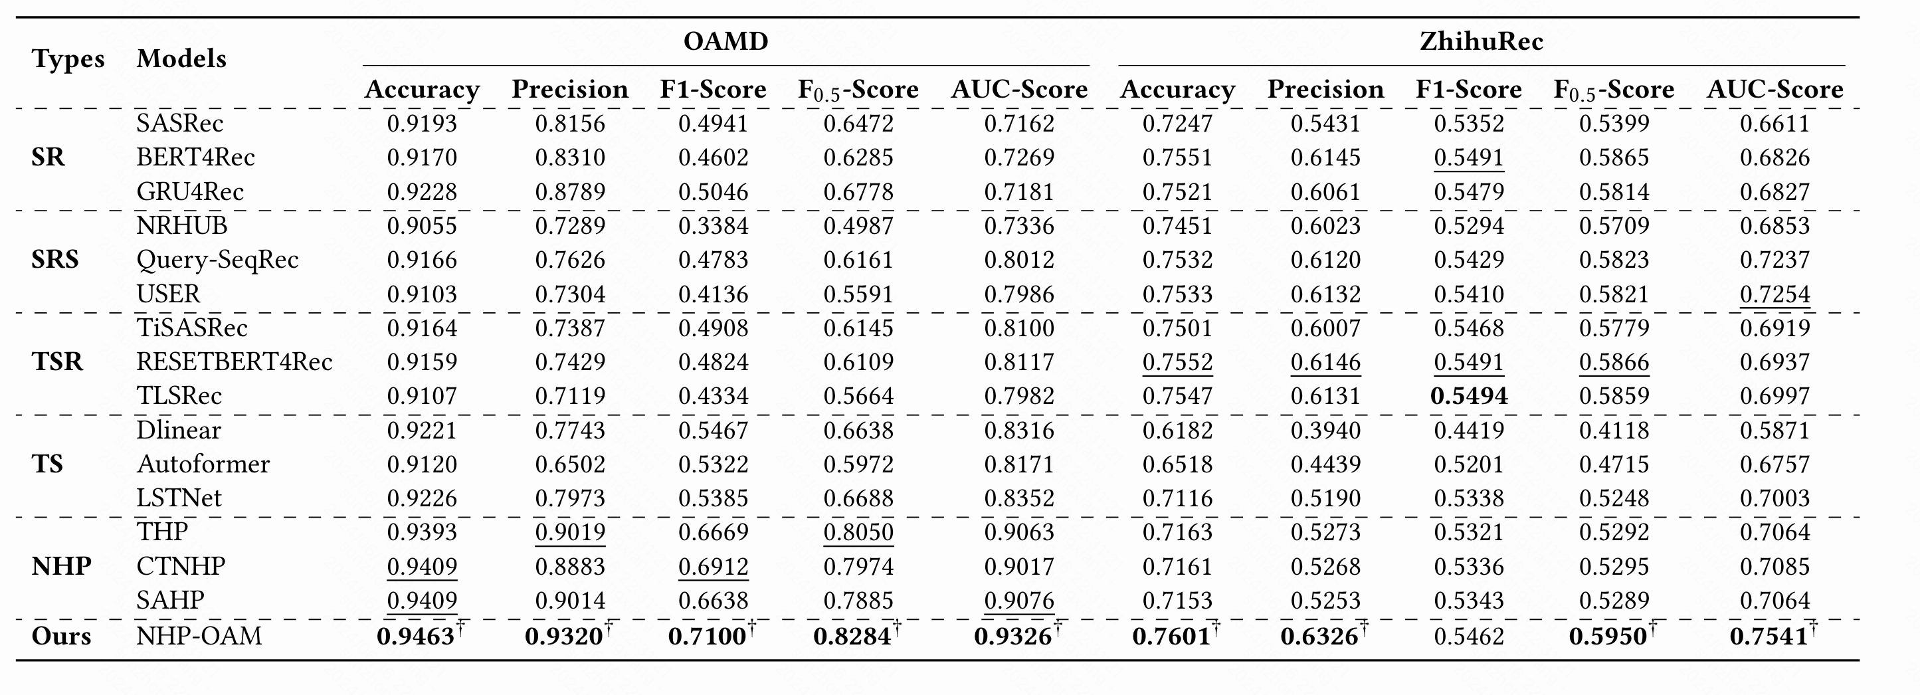

Experiments Results
SR
SRS
TSR
TS
NHP
NHP-OAM
TSR
v.s.
v.s.
TS
NHP-OAM
SR
NHP-OAM
NHP
SRS
Part information was insufficient.
Incorporate time, search and recommendation.
NHP can effectively capture the features in Open-App motivation but not optimal.
NHP-OAM performed better through adaptation design.
Notes:
NHP-OAM almostly outperformed baseline models on OAMD and ZhihuRec in five metrics.
NHP-OAM beat Time-Aware and Sequence Recommendation Models, showing the need to model user behavior patterns.
Time-Aware Models outperformed Sequence Models, highlighting the importance of time information.
NHP-OAM and Neural Hawkes Models outperformed Time-Series Models, proving they capture features without assuming consistent intervals.
NHP-OAM outperformed Neural Hawkes baselines, showing the effectiveness of our adaptation design.

Slide 17
Outline
Background
Methodology
Experiment
Conclusion

Slide 18
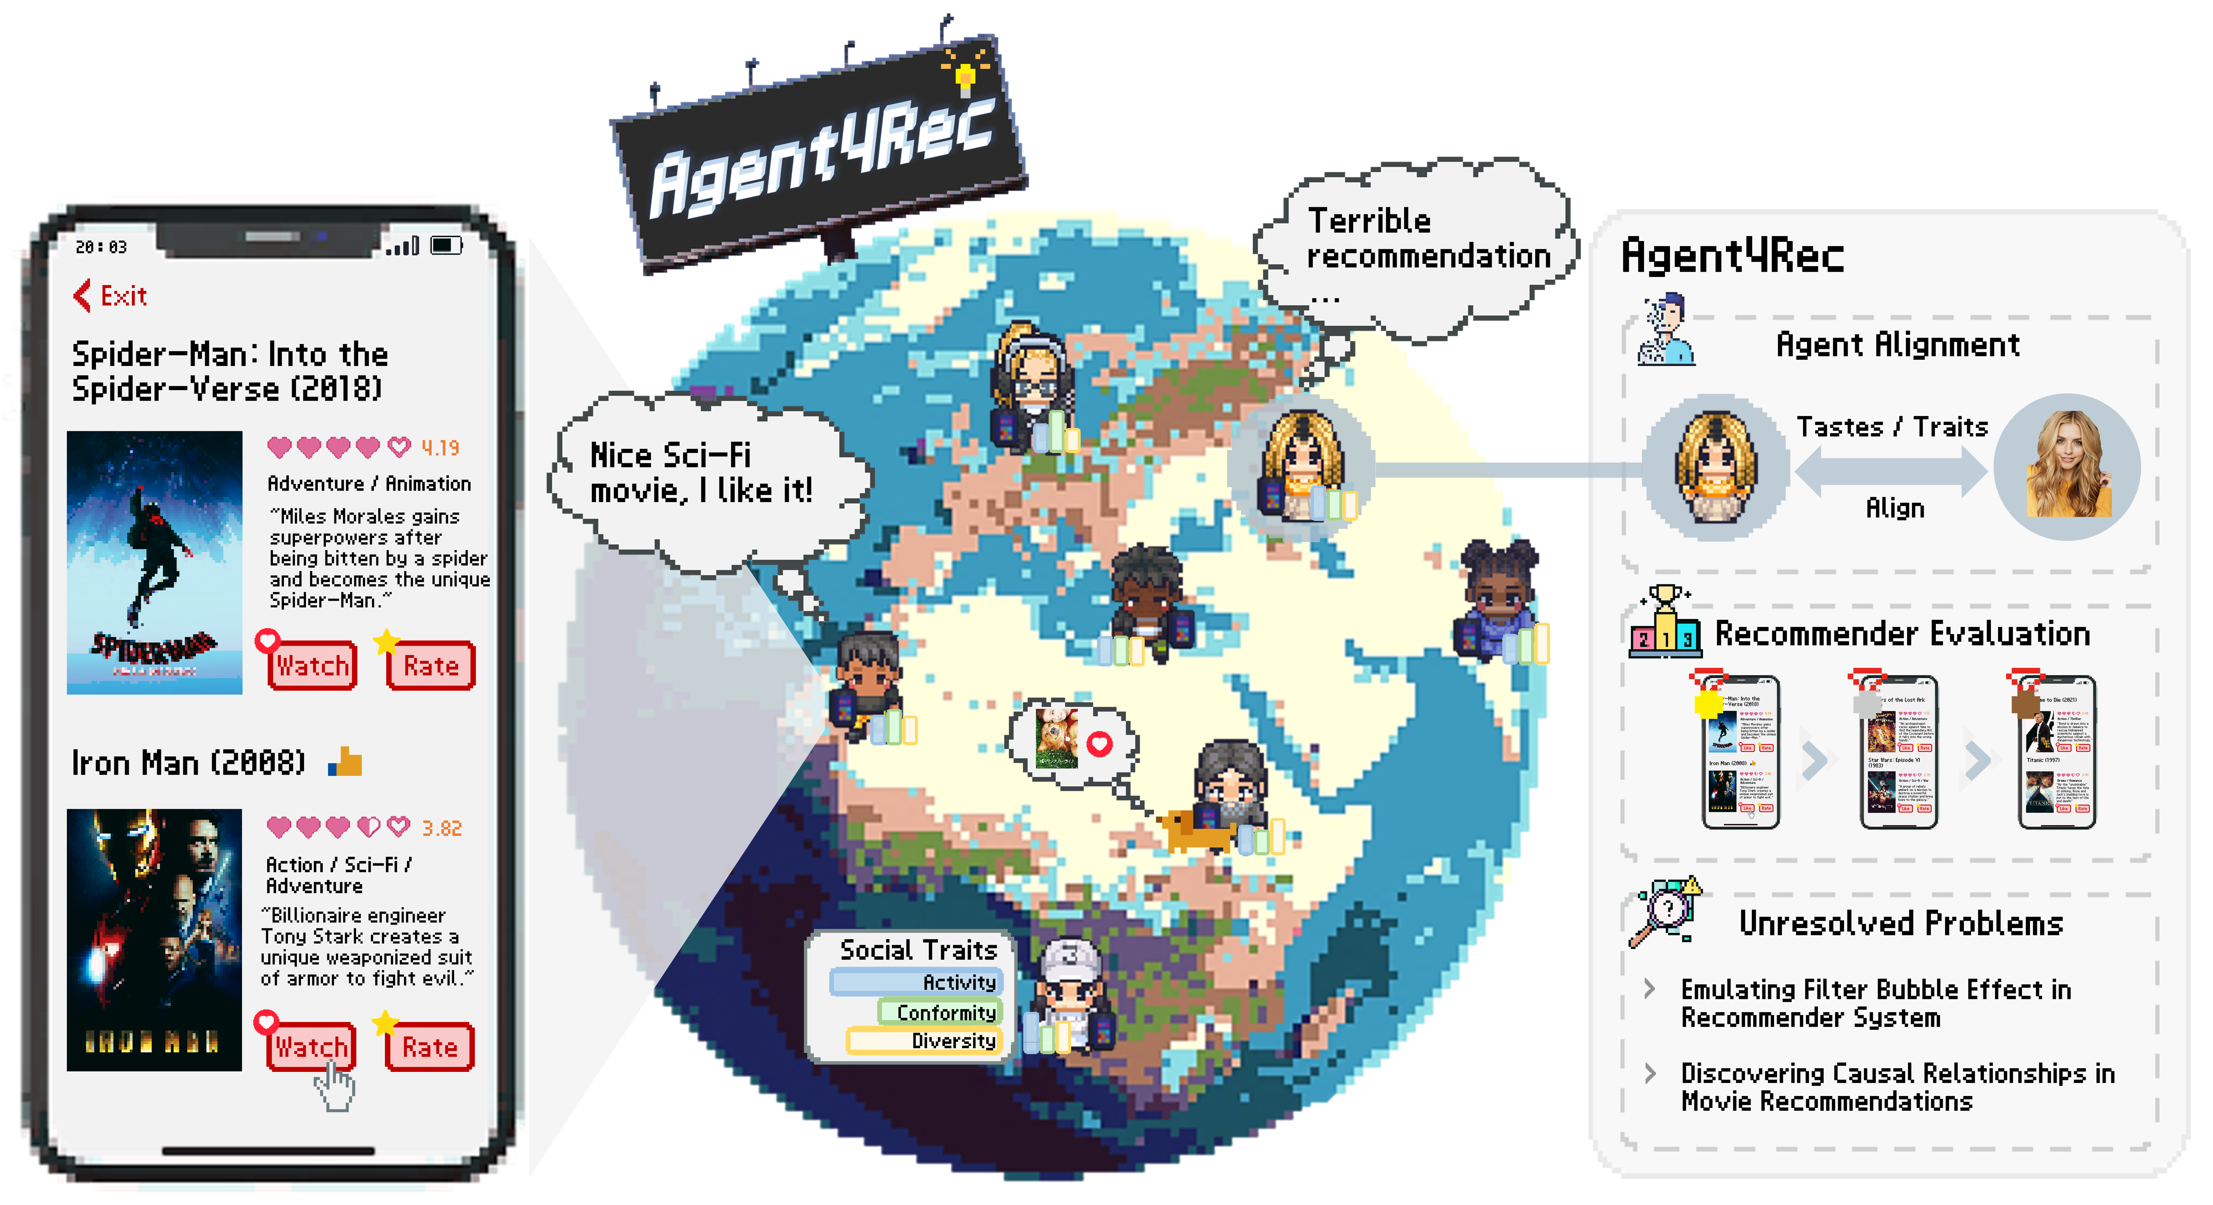
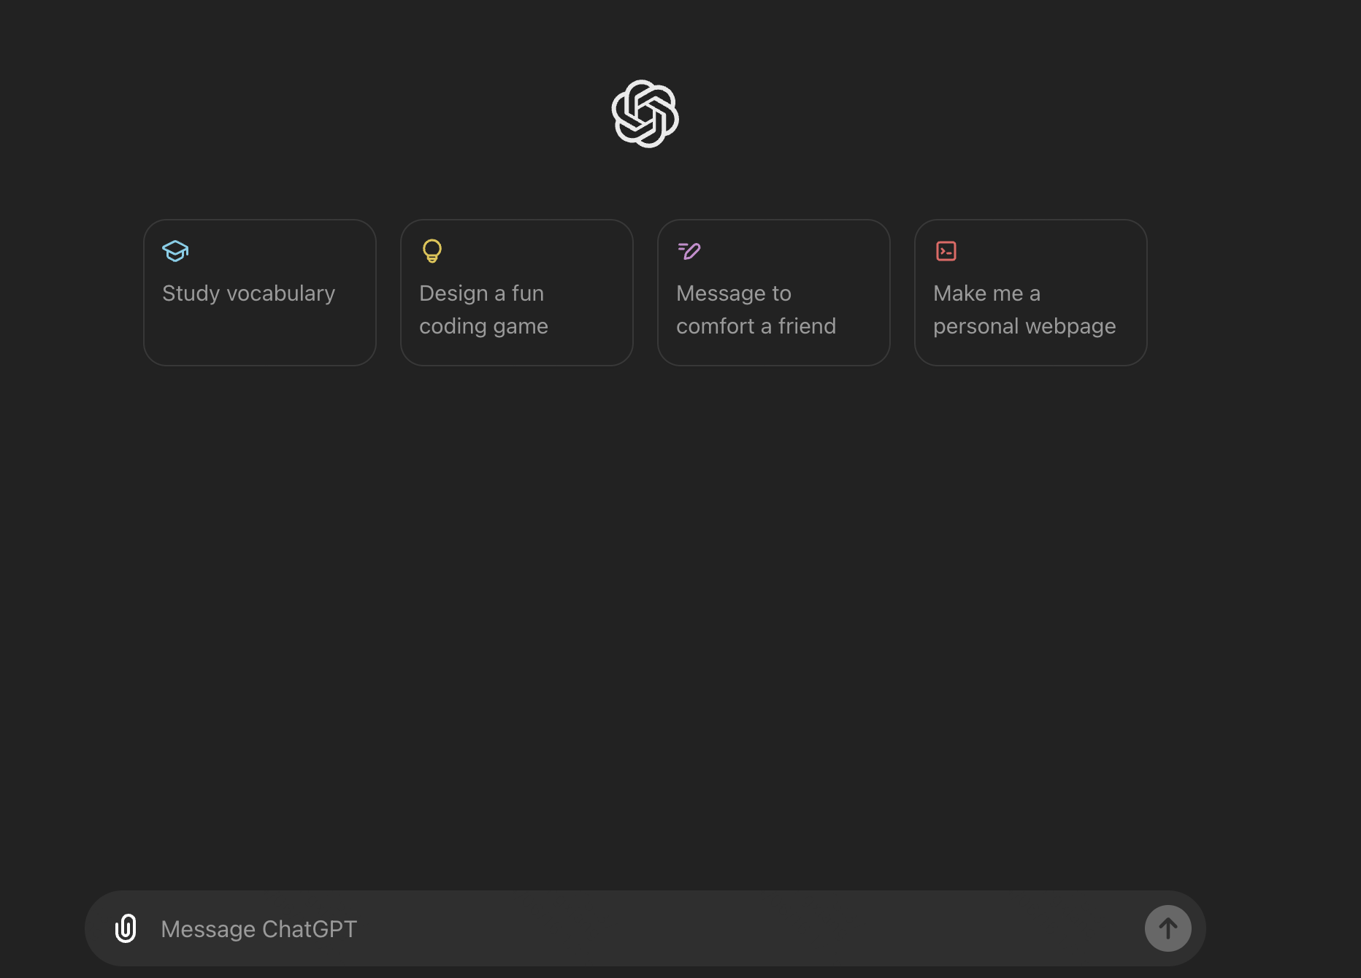

Future Directions
1. More refined modeling of Open-App Motivation.
2. Modeling user open-app motivation in the user simulation agents.
3. Construction of a more personalized conversational search/recommendation integrated engine by predicting user open-app motivation.
Recommendation
Search
Refined Motivations
Agent4Rec
ChatGPT
Notes:
加上动画，一个一个显示

Slide 19
Take away
A. We proposed the Open-App motivation task, which is common in daily life and holds significant commercial value.
Repeat-Query
Relevance
User interest
Periodicity
Periodicity
B. Neural Hawkes Process-based Open-App Motivation.
C. Open-app motivation can improve downstream task.
Previous
Not easy to find
Now
prominent
dynamically
Notes:
式子摆出来，实验结果去除
1. sig 2. 挑战 3. nhp 去解决+式子

Slide 20





KUAISHOU
TECHNOLOGY
THANKS!
Email: sunzhongxiang@ruc.edu.cn
www.kwai.com
www.kuaishou.com
Homepage: jeryi-sun.github.io
Kuaishou:
IIR Lab: ruc-iir-lab.github.io
Homepage:
Paper:
Whatsapp:
WeChat:

